Slide 1

Statistical Computation Methods for Data Science (6HC17)
Unit – 4, Lecture - 1
By
S.U.RAVI KUMAR CH
Assistant professor of Mathematics
Department of Science and Humanities
Sreenidhi Institute of Science and Technology
Yamnampet, Ghatkesar.
1
Notes:
1

Slide 2
Contents of the Lecture:
Introduction
Linear Model Selection and Regularization
Best Subset Selection
Forward Stepwise Selection
Backward Stepwise Selection
Optimal Model Selection

Slide 3
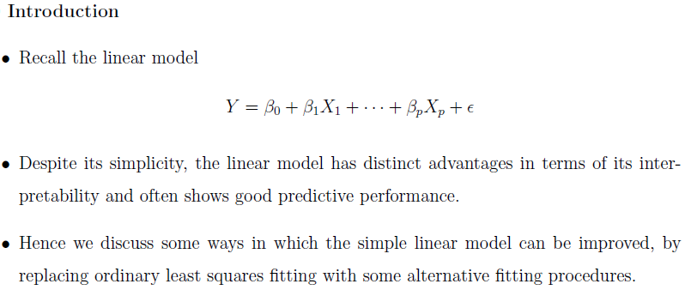

Slide 4
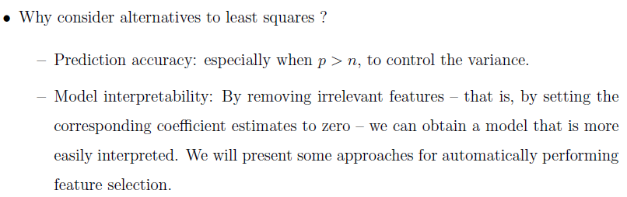

Slide 5
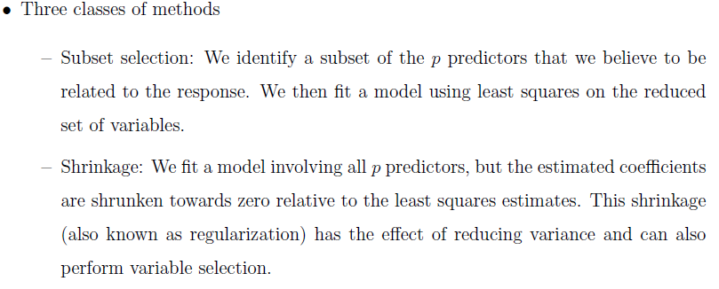
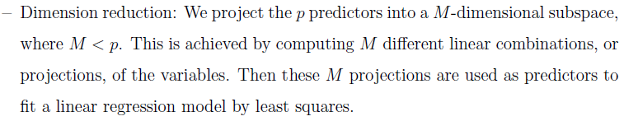

Slide 6

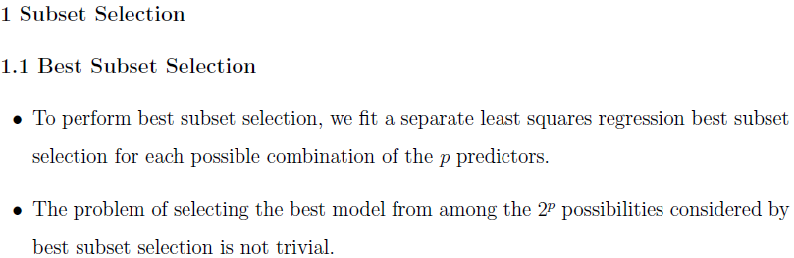

Slide 7
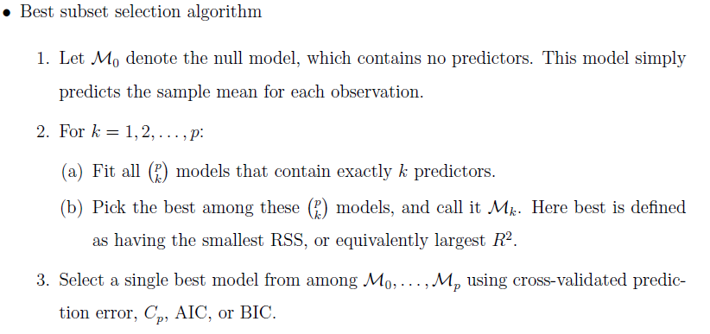

Slide 8

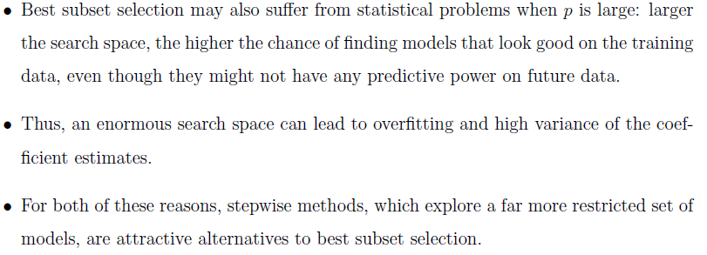

Slide 9
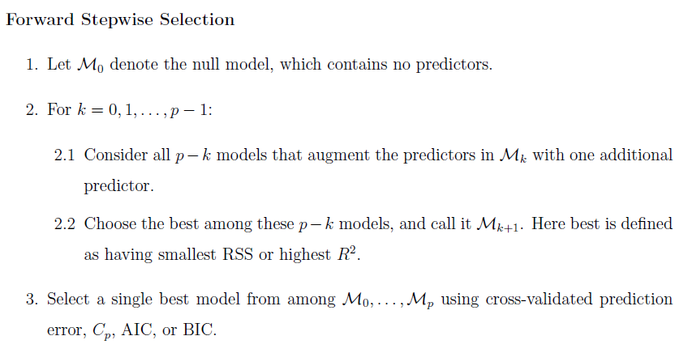

Slide 10
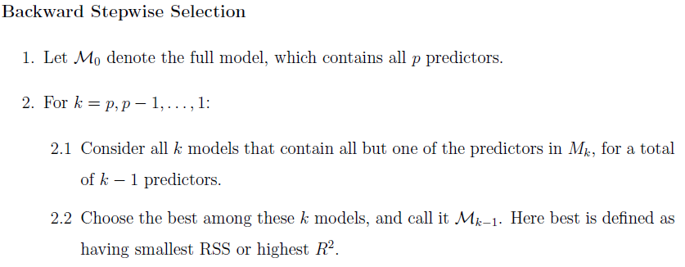

Slide 11

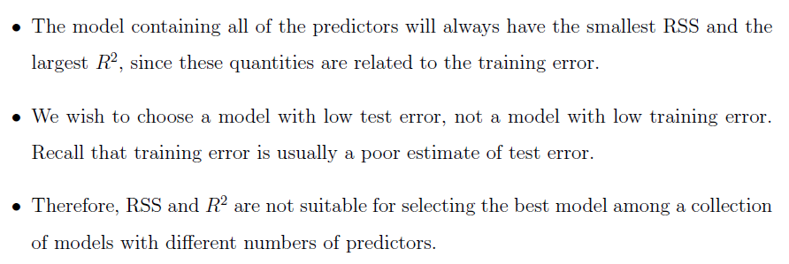
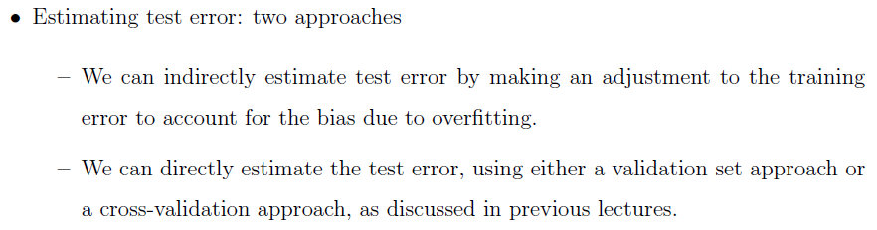

Slide 12
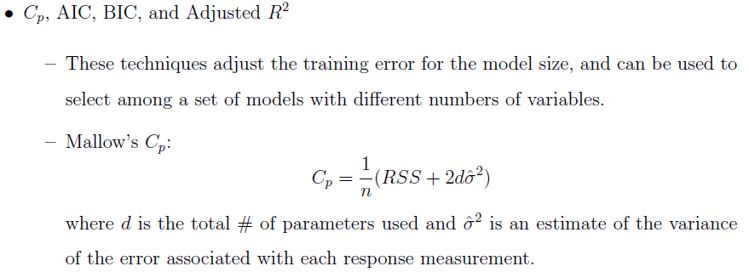
Cp = Cross-Validated prediction error
AIC = Akaike Information Criterion
BIC = Bayesian Information Criterion

Slide 13
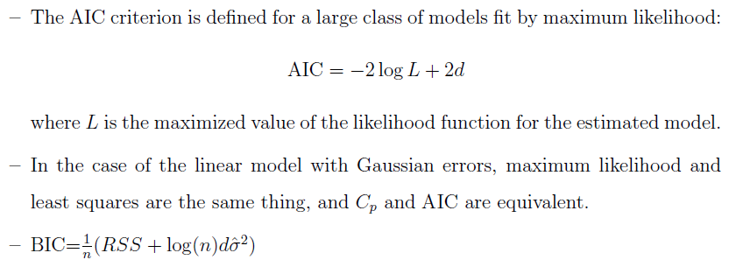

Slide 14
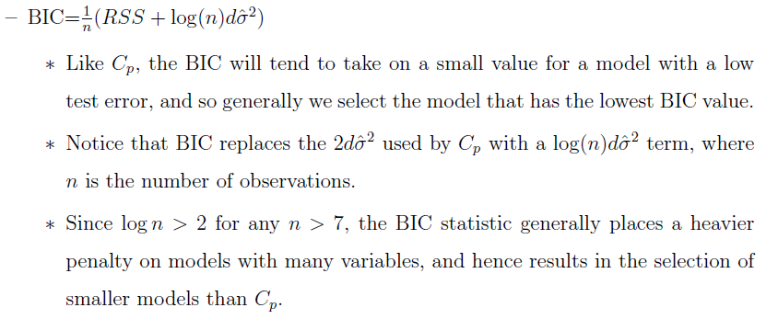

Slide 15
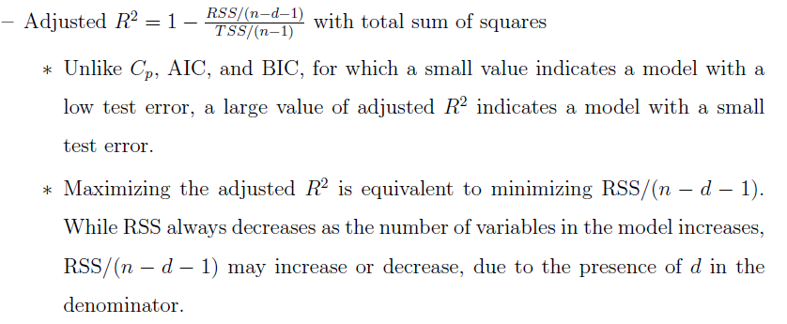

Slide 16
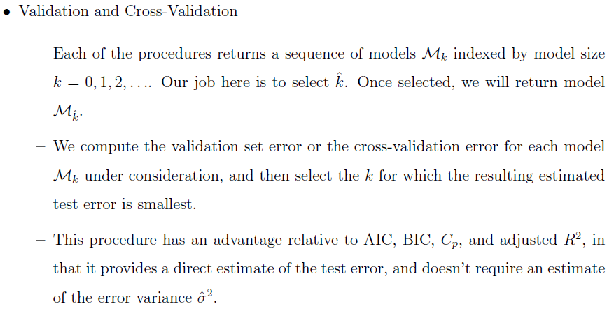

Slide 17
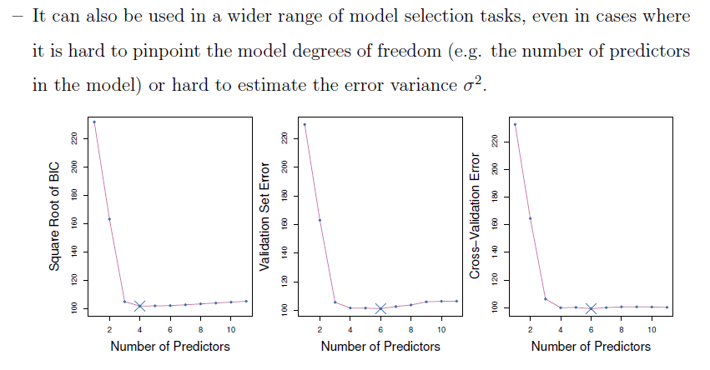

Slide 18
Recapitulation:
Linear Model Selection and Regularization
Best Subset Selection
Forward Stepwise Selection
Backward Stepwise Selection
Optimal Model Selection

Slide 19
THANK YOU
Notes:
19

